Slide 1


BAYESIAN MODELS FOR DOCKING SCORE PREDICTIONS
DS6040 Bayesian Machine Learning
Thomas Lever, Naomi Ohashi
December X, 2023

Slide 2
CONTENTS
INTRODUCTION
ABOUT DATA
METHODS
RESULTS
CONCLUSIONS

Slide 3
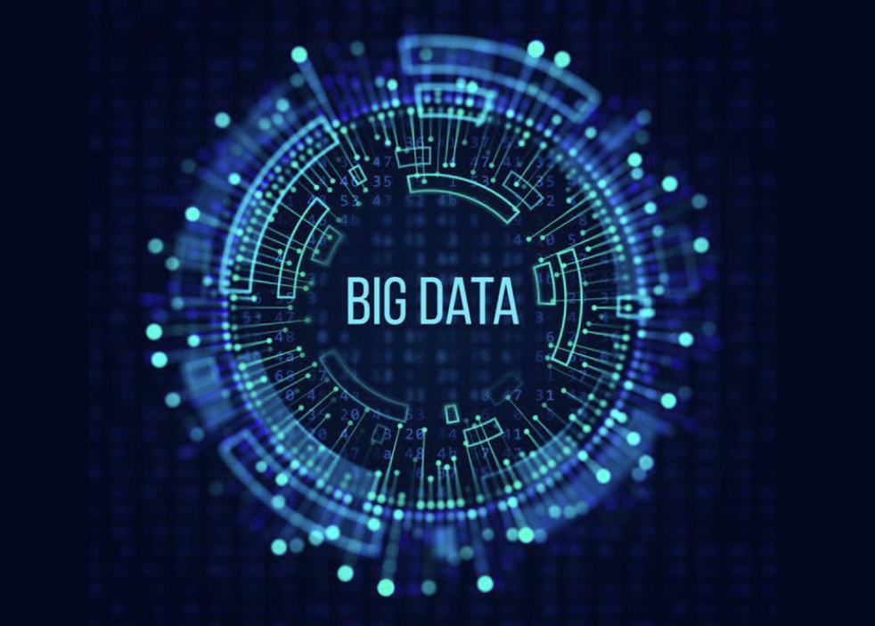
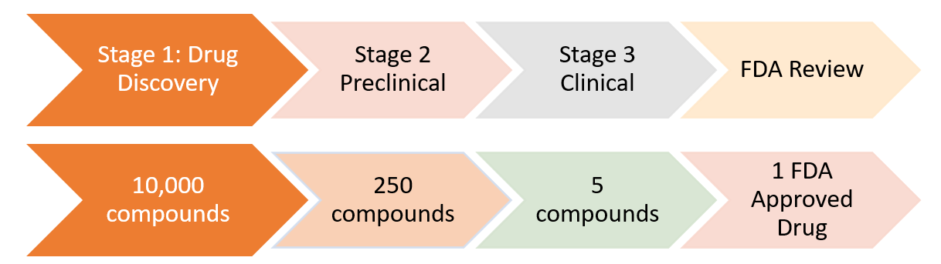
INTRODUCTION
CHALLENGES: Big Data
Drug-like chemical space is huge. Traditional approaches to drug discovery don’t scale.
The largest precalculated chemical database contains > 160 billion chemicals
Drug-like chemical space is >10⁶⁰
Drug development takes many years and expensive with low success rate
Timeline: ~15 years
Cost: over $2.6 billion
Notes:
Costs for bringing a new drug to market was about $1.8 billion in 2010 according to a study (https://en.wikipedia.org/wiki/Cost_of_drug_development)
Chemical space has tens of millions of molecules
Makable chemical space has tens of billions of molecules

Slide 4
CHALLENGES: Big Data
Drug-like chemical space is huge. Traditional approaches to drug discovery don’t scale.
Drug development takes many years and expensive with low success rate
The largest precalculated chemical database contains > 160 billion chemicals
Drug-like chemical space is >10⁶⁰
Bayesian ML models help scale up drug discovery process by predicting docking score efficiently
Saves money and time by accelerating the process, hopefully that leads to cheaper and faster treatment available for patients
This project won’t solve the big problems but could contribute to a small piece
Timeline: ~15 years
Cost: over $2.6 billion
Notes:
Costs for bringing a new drug to market was about $1.8 billion in 2010 according to a study (https://en.wikipedia.org/wiki/Cost_of_drug_development)
Chemical space has tens of millions of molecules
Makable chemical space has tens of billions of molecules

Slide 5
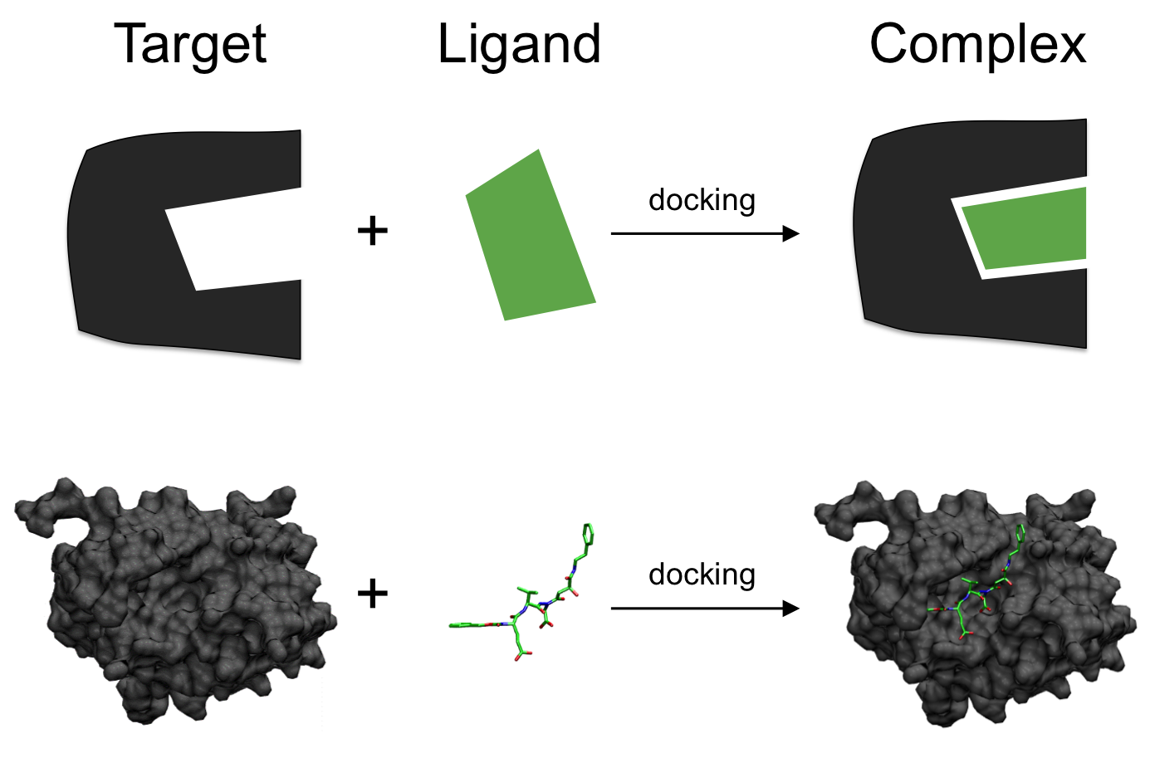
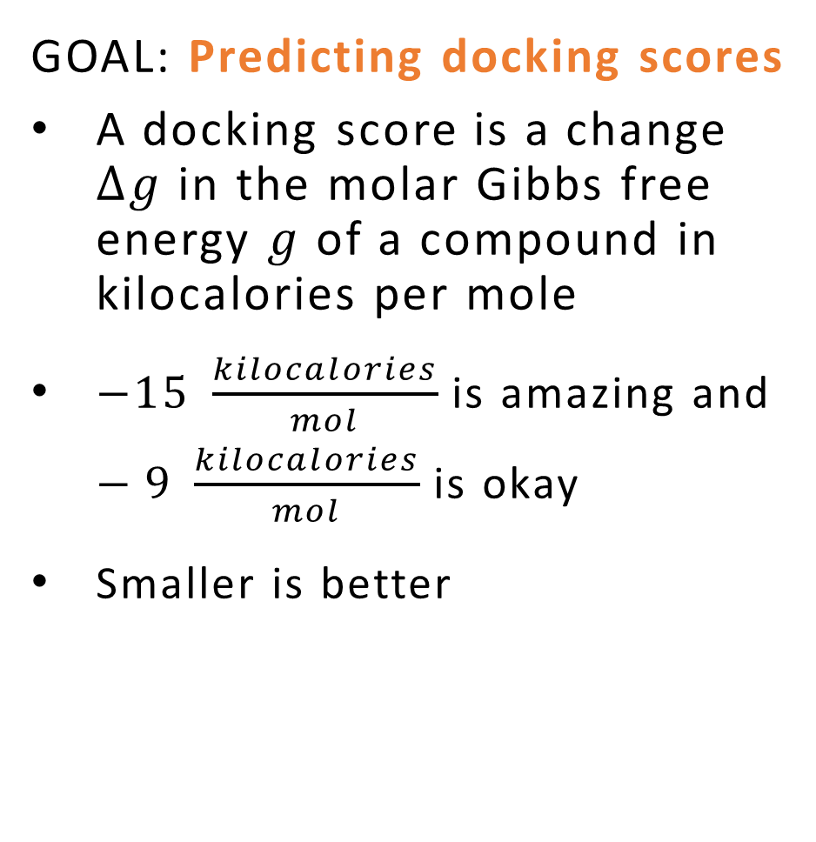
GOAL
GOAL: Predicting docking scores
A docking score is a change $∆g$ in the molar Gibbs free energy $g$ of a compound in kilocalories per mole
$−15 \frac{kilocalories}{mol}$ is amazing and $−9 \frac{kilocalories}{mol}$ is okay
Smaller is better
Source: https://en.wikipedia.org/wiki/Docking_(molecular)
Notes:
Docking is a computational simulation of a candidate ligand binding to a receptor
Scoring is a process of evaluating a pose by counting number of favorable molecular interactions

Slide 6
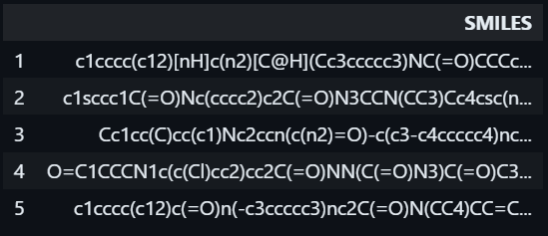
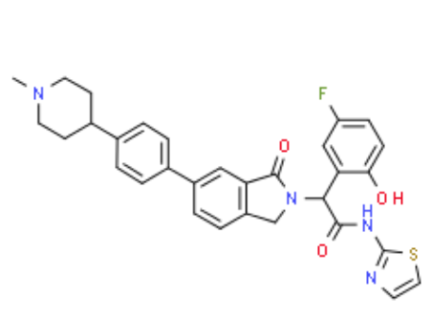
ABOUT DATA
7JXQ protein target may cause lung, breast, or other cancers.
Data set is associated with one site at which ligands bind.
The raw data set has 2,121,227 observations and each with a docking score and SMILES.
Each row encapsulates data relating to a ligand docking to the protein.
There is one ligand per row. There is one Entry ID per ligand.
Each ligand has SMILES (Simplified Molecular-Input Line-Entry System), a line notation for chemical structure.
Source: https://en.wikipedia.org/wiki/Simplified_molecular-input_line-entry_system
Notes:
Each row encapsulates data relating to a ligand docking to the protein:
- Molecular Weight <= 500 Da
- No. Hydrogen Bond Donors <= 10
- No. Hydrogen Bond Acceptors <= 5
- LogP <= 5

Slide 7

METHODS
Bayesian Docking-Score Predictor
The Bayesian Docking-Score Predictor receives SMILES of a ligand and provides a docking score that approximately predict the binding affinity between two molecules.
RDKit function called Morgan Fingerprints translates 2 millions of SMILES into vector counts
Predictive models trained with:
- Bayesian Additive Regression Tree (BART)
- Bayesian Neural Network (BNN)
Sampling:
- pymc to sample testing values of $\hat{y}$ from the posterior predictive probability density distribution
- No U-Turn Sampling (NUTS) is used to train the BNN
Visualization: Plots Of Posterior Predictive Check, ROC curves and Trace plots presents improvements in results visually
Notes:
The Bayesian Docking-Score Predictor receives SMILES of a ligand and provides a docking score of how well that ligand binds to a protein

Slide 8
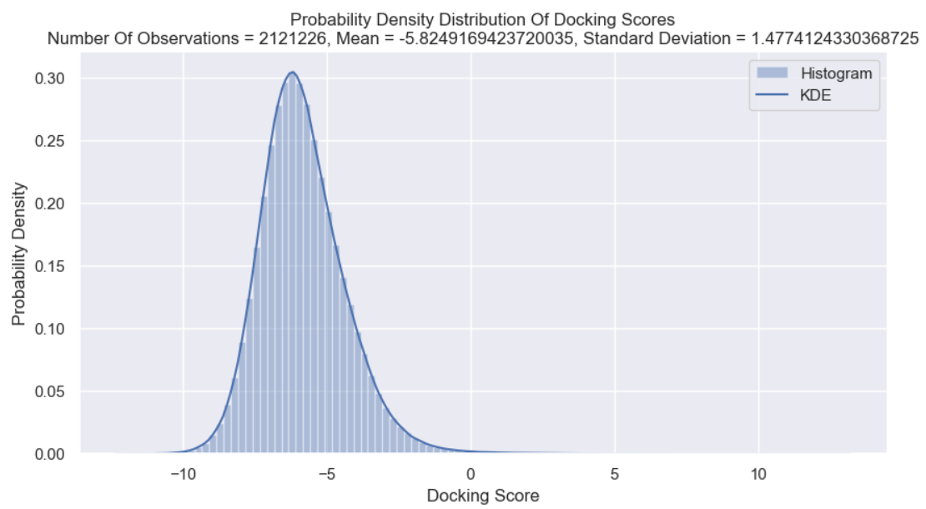
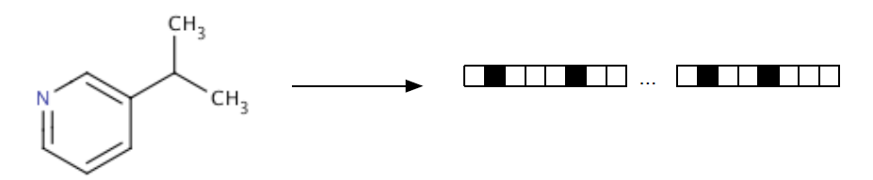
EXPLORATORY DATA ANALYSIS AND DATA WRANGLING
Probability Density Distribution of Docking Score
The histogram of the PDF and kernel density estimation (KDE) which is smoothing for probability density estimation.
The mean of the docking score is -5.829 and standard deviation of 1.477.
Morgan2 Fingerprints
RDKit descriptor called Morgan Fingerprints generate count vector and using them to calculate molecular similarity.
count vectors : fpgen.GetCountFingerprint
Each vector of numbers of occurrences of substructures is folded into a vector of 1024 numbers of occurrences of substructures.
Notes:
Probability density function (PDF) of docking score is shown for the whole dataset. The histogram of the PDF and kernel density estimation (KDE) which is smoothing for probability density estimation. The mean of the docking score is -5.829 and standard deviation of 1.477.
Each vector of numbers of occurrences of substructures is folded into a vector of 1024 numbers of occurrences of substructures.
We construct a training and testing feature matrix where each row contains a docking score and 1024 numbers of occurrences of substructures. Our feature matrix has up to 2,121,226 observations.

Slide 9
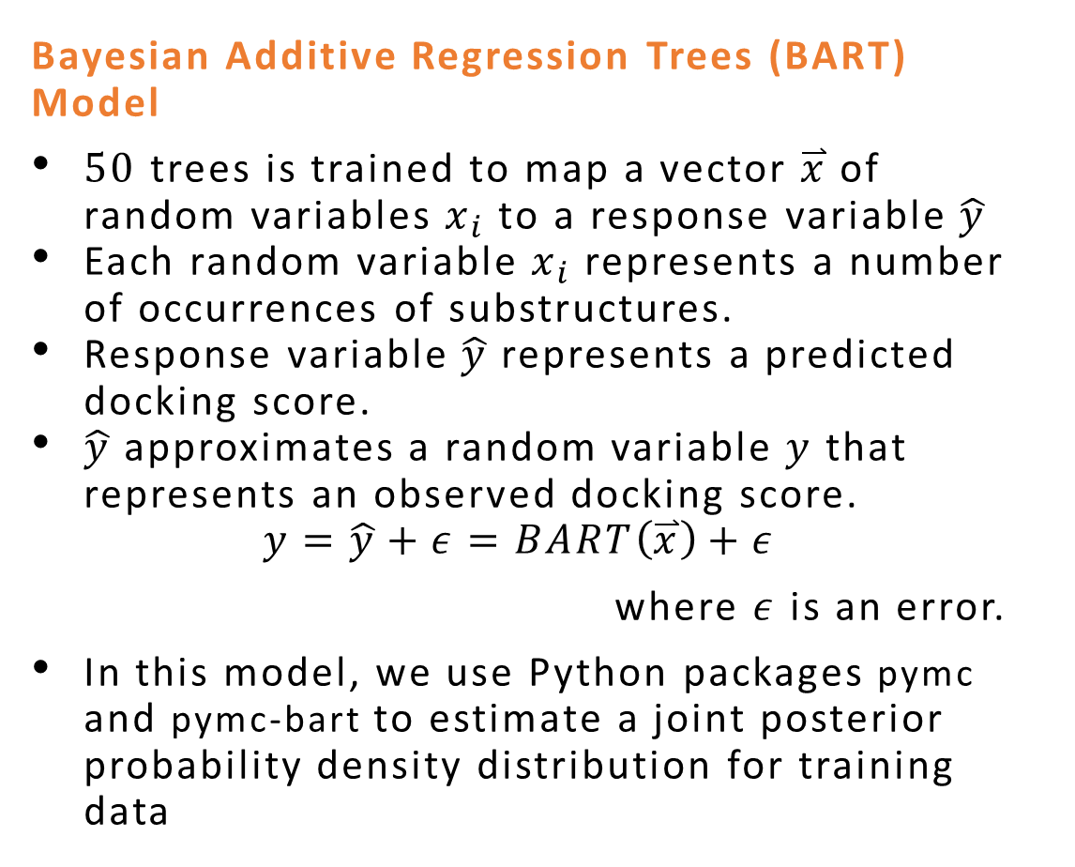
PREDICTIVE MODELS(BART)
Bayesian Additive Regression Trees (BART) Model
$50$ trees is trained to map a vector $\overset{⃑}{x}$ of random variables $x_{i}$ to a response variable $\hat{y}$
Each random variable $x_{i}$ represents a number of occurrences of substructures.
Response variable $\hat{y}$ represents a predicted docking score.
$\hat{y}$ approximates a random variable $y$ that represents an observed docking score.
$$y=\hat{y}+ε=BART\left(\overset{⃑}{x}\right)+ε$$
where $ε$ is an error.
In this model, we use Python packages pymc and pymc-bart to estimate a joint posterior probability density distribution for training data

Slide 10

PREDICTIVE MODELS(BNN)
Bayesian Neural Network (BNN) Model
A neural network is trained to map a vector $\overset{⃑}{x}$ of random variables $x_{i}$ to a response variable $\hat{y}$.
$\hat{y}$ is multiplied by the range of observed response values $y$.
An input layer through which the BNN receives an input matrix $X∈R^{m×1024}$
A first hidden layer
A second hidden layer
An output layer

Slide 11
RESULTS

Slide 13
CONCLUSIONS

Slide 14

Drug Discovery Process
Timeline: ~15 years
Cost: over $2.6 billion
Stage 1: Drug Discovery
Stage 3 Clinical
10,000 compounds
250 compounds
5 compounds
Stage 2 Preclinical
FDA Review
1 FDA Approved Drug

Slide 15
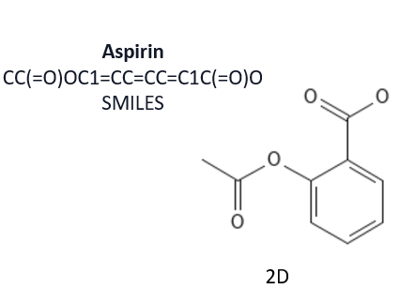
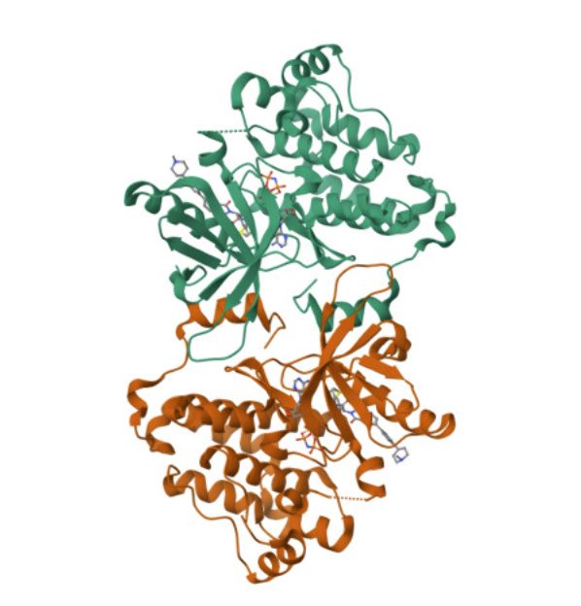
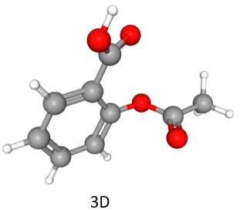
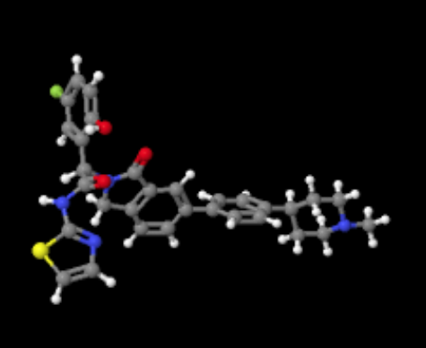

Slide 16
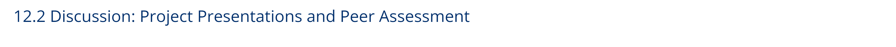
Project Deadlines:
Video of presentation (record with Zoom or similar, then submit via MS Teams)
No Report or other material needs to be handed in.
Presentation Sections:
Introduction (state your problem, overview, table of contents)
Methods (what you did, algorithms uses)
Results (output of your work. Lots of plots, little ‘commentary’)
Conclusions (what to you conclude? What worked and what didn’t. Surprises. Things you would change or do in the future. Advice.)
Chapter 1

